Slide 1
Employee Data Analysis using Excel
STUDENT NAME : HEMANTH S
REGISTER NO : 122203667 (ansunm1611d22cp017)
DEPARTMENT : B.Com Corporate Secretaryship
COLLEGE : Patrician College of Arts and Science

Slide 2
PROJECT TITLE
Employee Performance Analysis using Excel

Slide 3


AGENDA
Problem Statement
Project Overview
End Users
Our Solution and Proposition
Dataset Description
Modelling Approach
Results and Discussion
Conclusion
3/21/2024 Annual Review

Slide 4

PROBLEM STATEMENT
To develop a comprehensive Excel-based analysis system to evaluate and enhance employee performance within the organization. This system should aggregate performance data, provide meaningful insights through data visualization and analysis, and support decision-making for performance management and employee development.

Slide 5

PROJECT OVERVIEW
To design and implement an Excel-based system for evaluating employee performance, facilitating performance reviews, and identifying areas for improvement. The system will consolidate performance data, provide insightful analysis, and support data-driven decision-making within the organization.

Slide 6
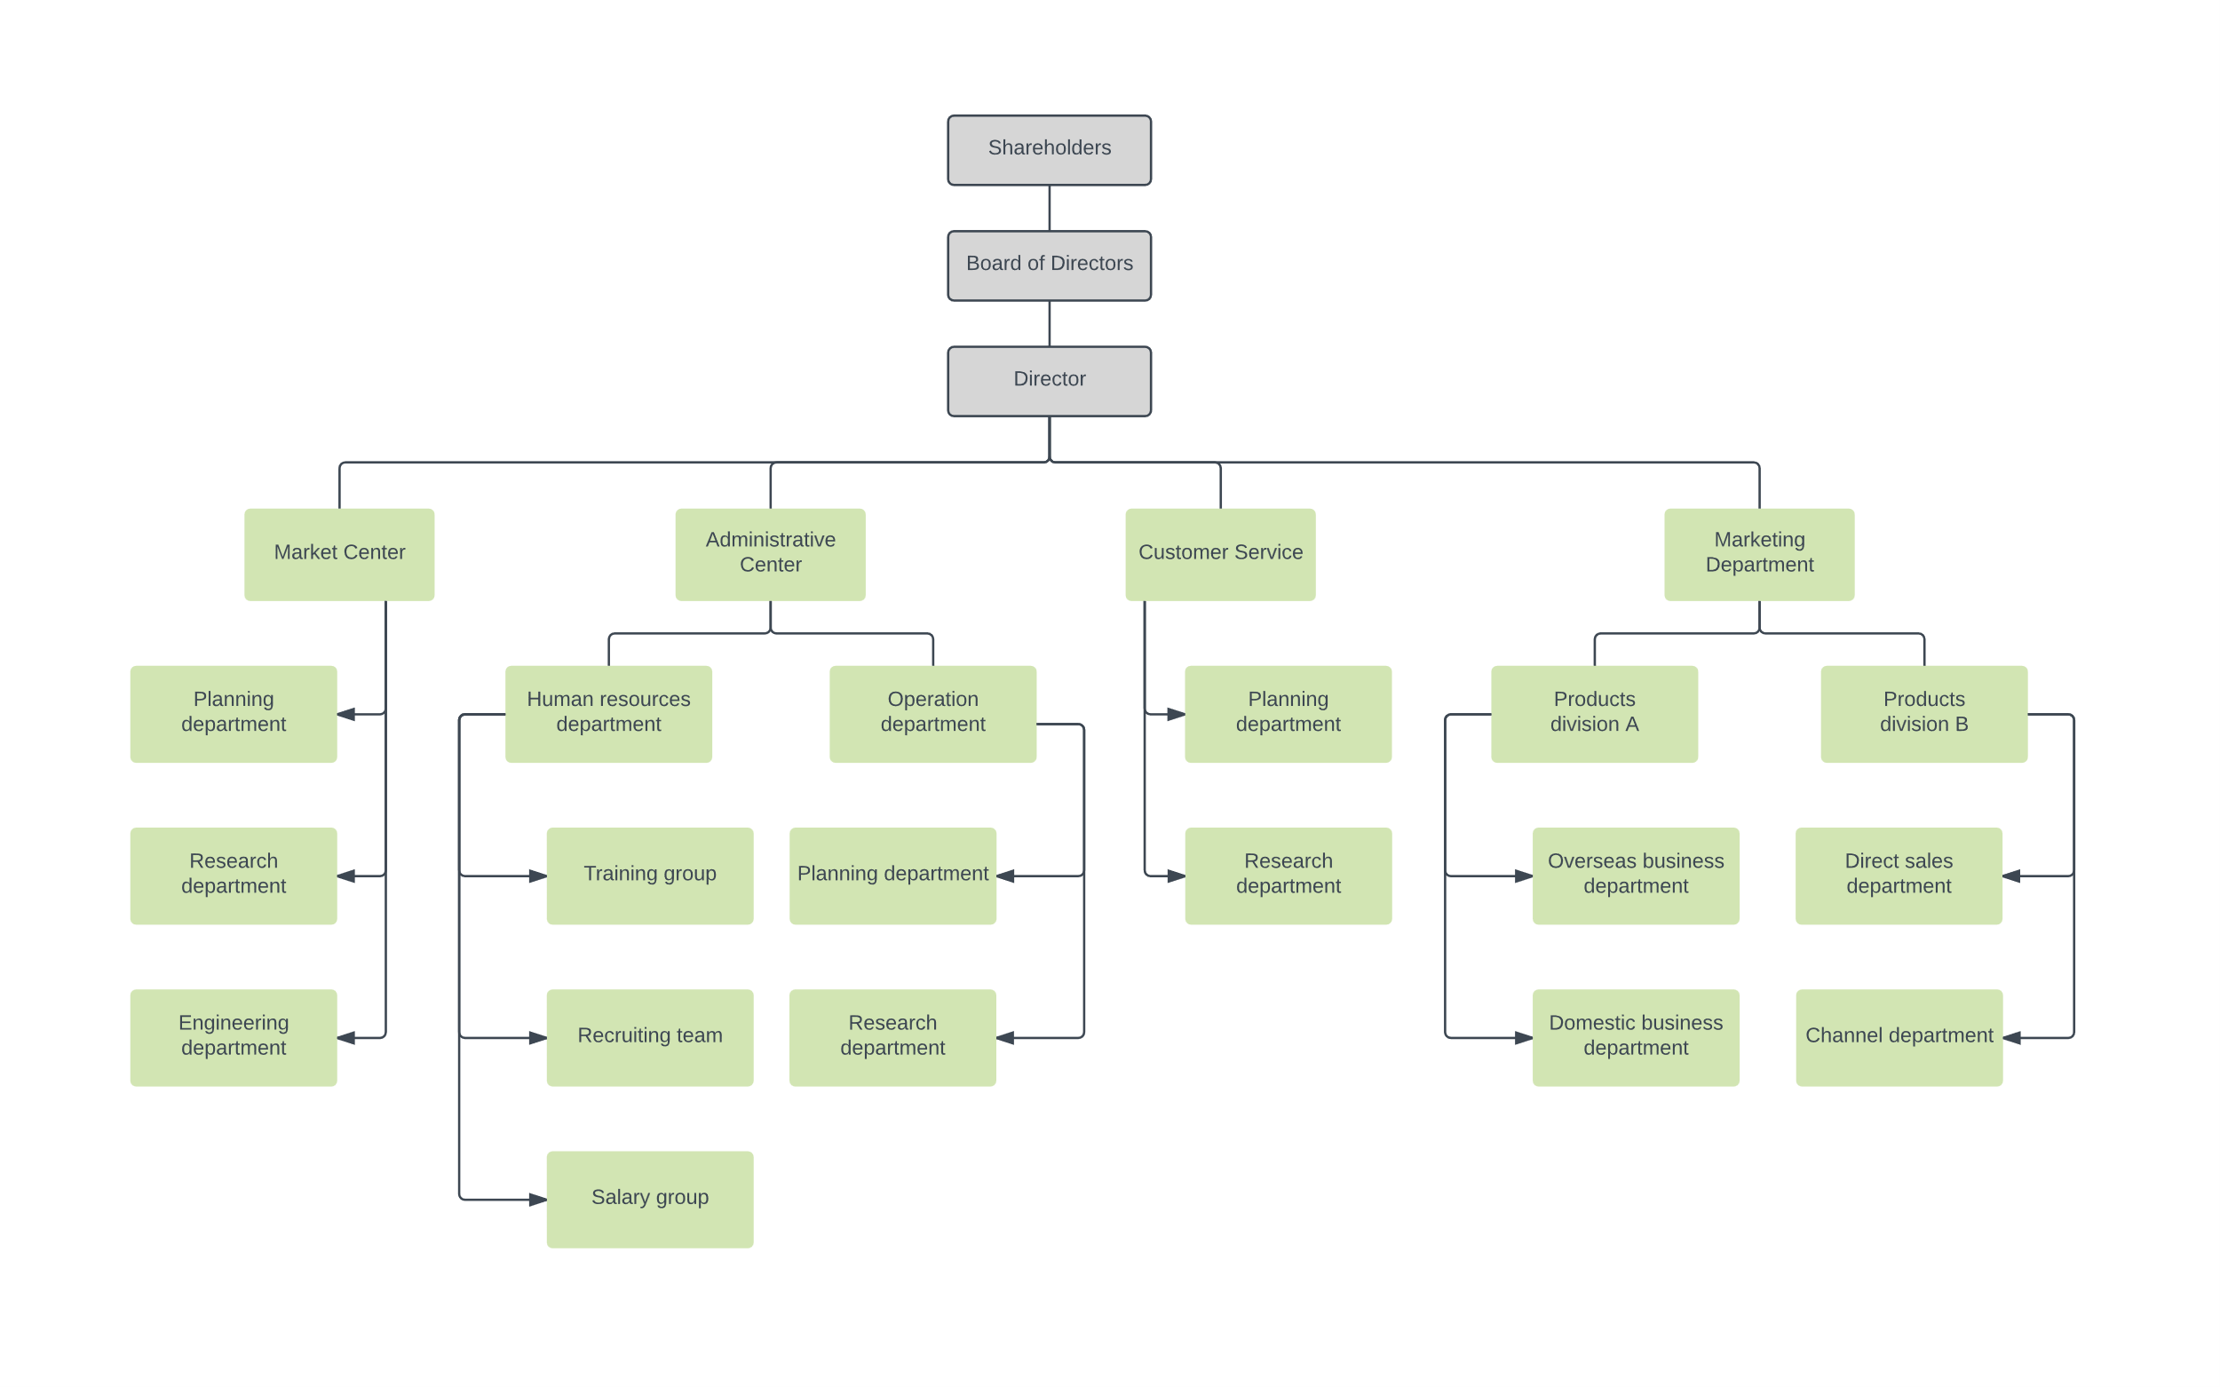

WHO ARE THE END USERS?

Slide 7

OUR SOLUTION AND ITS VALUE PROPOSITION
Conditional Formatting Missing
Filter Remove
Formula Performnce
Pivot Chat Analysis Summary
Graph Data Visualiztion

Slide 8
Dataset Description
Employee – Kaggle
26 – Features
Employee id – Numerical
Name – Text
Employee Types
Performance Level
Gender – Male, Female

Slide 9

THE "WOW" IN OUR SOLUTION
Formula:
Performance Level :
IFS(Z8>=5,"VERY HIGH",Z8>=4,"HIGH",Z8>=3,"MEDIUM",TRUE,"LOW")
=
9

Slide 10
MODELLING
Data Collection
Employee id
First Name
Last Name
Business Unit
Employee States
Employee Types
Performance Level
High
Medium
Low
Summary
Data Collection
First Name
Last Name
Business Unit
Data cleaning
Performance Level
Formula
Missing Value
Employee States
Employee types
Feature Collection
Formula
Performance level
Data Cleaning
Missing Value
Performance level
10

Slide 11
RESULTS
11

Slide 12
conclusion
The development of an Employee Performance Analysis System using Excel represents a significant step forward in enhancing how employee performance is evaluated and managed within the organization. By consolidating diverse performance data into a structured and interactive Excel-based system, the organization will benefit from

